Slide 1
EFIC & the path to 2020
Andrew Hunter, Managing Director & CEO
AEBF Annual Meeting, 17 November 2014

Slide 2
Efic & The Path to 2020
Rationale for setting up – Australian context
Experience so far – filling the “market gap”
Are ECAs still relevant?
What lies ahead? Efic’s focus
Challenges to future growth and measuring success
When it comes to operating a successful ECA, change is the only constant

Slide 3
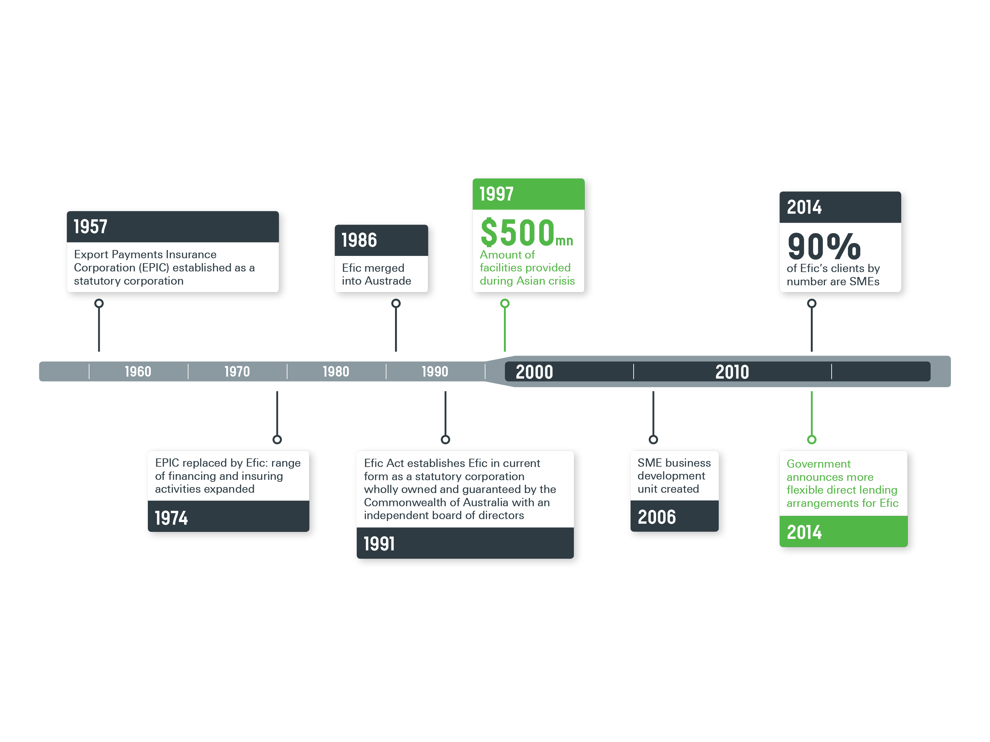

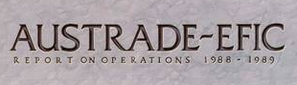



Rationale for Setting Up: Australian Context
v

Slide 4
Rationale for Setting Up: Australian Context
Australia’s top 10 export markets (b) (A$ million)
 | Goods | Services | Total | Share
China | 94,655 | 6,881 | 101,536 | 31.9
Japan | 47,501 | 1,991 | 49,492 | 15.5
Republic of Korea | 19,610 | 1,675 | 21,285 | 6.7
United States | 9,580 | 5,951 | 15,531 | 4.9
India | 9,517 | 1,921 | 11,438 | 3.6
New Zealand | 7,399 | 3,626 | 11,025 | 3.5
Singapore | 5,659 | 3,549 | 9,208 | 2.9
Taiwan | 7,356 | 704 | 8,060 | 2.5
United Kingdom | 3,859 | 3,982 | 7,841 | 2.5
Malaysia | 5,561 | 1,664 | 7,225 | 2.3
Total exports | 263,467 | 55,175 | 318,642 | 100.0

Slide 5
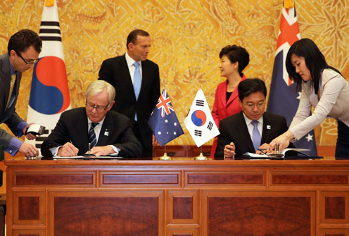
Rationale for Setting Up: Australian Context
Trade Agreements
Seven FTAs in force – NZ, Singapore, Thailand, US, Chile, ASEAN, Malaysia – 26% of Australia’s total trade.
Two signed in 2014: Korea, Japan EPA; 5% and 11% of Australia’s trade.
Seven in negotiation
3 bi-lateral: China, India, Indonesia
4 pluri-lateral: TPP, GCC
PACER Plus, RCEP
Minister for Trade and Investment, The Hon Andrew Robb MP signs KAFTA

Slide 6
Experience So Far - Working in the Market Gap
Ongoing adaptation – 10 year snapshot
2003 – Divested short-term credit insurance business
2006 – Established SME book
2008 – Post-GFC market prompts assistance for export projects in Australia
2011 – Domestic assistance shifts to helping SME subcontractors
2012 – SME business origination offices opened around Australia
2014 – Direct lending flexibility to assist more SMEs
But some things do stay the same...
Commercial operations, self-funding
Non-compete mandate
Importance of our partnerships
Maintaining capacity to respond to crises

Slide 7

Are ECAs still relevant?
ECA relevance as a policy tool
Scrutiny from Government / Commentators
The “Corporate Welfare” debate – US Exim
Productivity Commission review of Efic 2012
Changing nature of international business
International supply chains
Overseas Investment
SMEs active in international business
New policy priorities
Are ECAs still relevant today in an increasingly liberalised, integrated trading environment where information is more accessible?

Slide 8
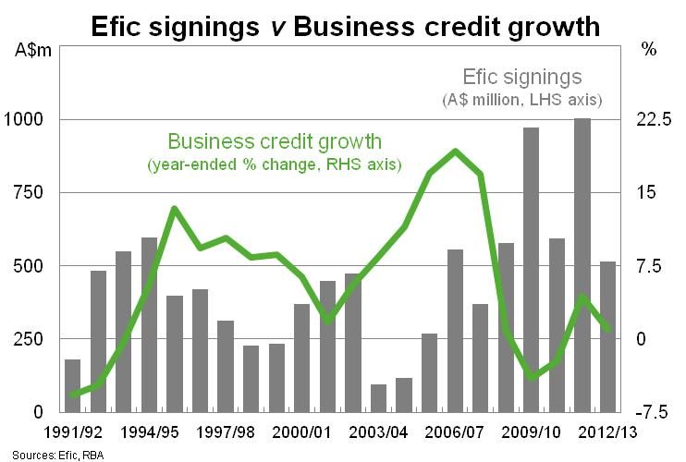
Are ECAs still relevant?
Yes, market failures exist and ECAs remain an important tool to address those failures
Crises
Lessons learned – Asian financial crises 1997/98, Latin America debt crises 2001/2, GFC 2008/9
European experience – bank capacity post-GFC

Slide 9
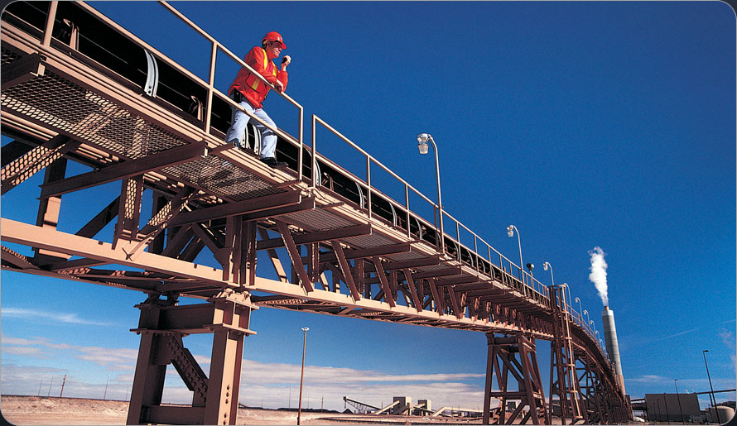

Are ECAs still relevant?
Ongoing demand for capital beyond private market capacity
Major resource and infrastructure projects in our region
$8 trillion infrastructure investment in Asia, $750 bn in financing each year to 2020
ECAs leading private capital in project finance – the new norm?
AEBF – important role in training and knowledge transfer

Slide 10
What lies ahead? Towards 2020
EFIC – Our Focus
Doing more for SMEs
More flexible direct lending arrangements
Expanding access to services for “small” SMEs
Supporting overseas direct investment
Simplifying execution and documentation processes
Non-SME support:
Frontier and emerging market focus (although not exclusively)
Project finance, Australian content including – SME participation

Slide 11
Challenges for future growth
Key Issues
Capacity
A new international framework?
Measuring our success
Channel management
Maintaining relevant skill-sets

Slide 12
Conclusion
Efic continues to change over time – responding to movements in the “market gap” and reflecting the changing nature of international business
The role of ECAs is being challenged. But, ECAs remain relevant and effective in addressing market failures:
Importance of capacity to respond to crises
Financing the infrastructure our region needs to grow
Responding to changing nature of international business
Greater participation by SMEs
Supply chains
Overseas direct investment
We face some challenges: capacity, channel management, how to measure success, international frameworks
Cooperation and collaboration is key to overcoming these hurdles.

Slide 13
Disclaimer
This material (Information) has been prepared by Efic for information purposes only. It is in summary form and is therefore not necessarily complete.
It is not an offer by Efic to make available to any party any of the financial products referred to in the Information (Products) and the Information must not, in any way, be construed as specific or general advice in respect of any Products. A person or entity should seek their own advice as to the suitability of any Products for their own financial or tax circumstances. Whilst reasonable care has been taken to ensure that the Information is not untrue or misleading, no representation is made as to its accuracy or completeness and no liability is accepted for any loss arising from reliance upon the Information.
In accordance with applicable exemptions, Efic is not required to hold an Australian financial services licence nor is it regulated by the Australian Prudential Regulation Authority in connection with any of the Products.

